Slide 1

Software Project III Presentation
Project Title: CringCring - A Cycle Rent Website
Presented By
Swarnaly Sarker : 221-15-5943

Slide 2
Outline
Objective
Design Phase
Development Phase
Future Work
Conclusion
Software Project III Presentation

Slide 3
Objective
Eco- friendly
Save money
Reduce time waste
Stay fit
Used the unused vehicles
To get easily rent
Software Project III Presentation

Slide 4
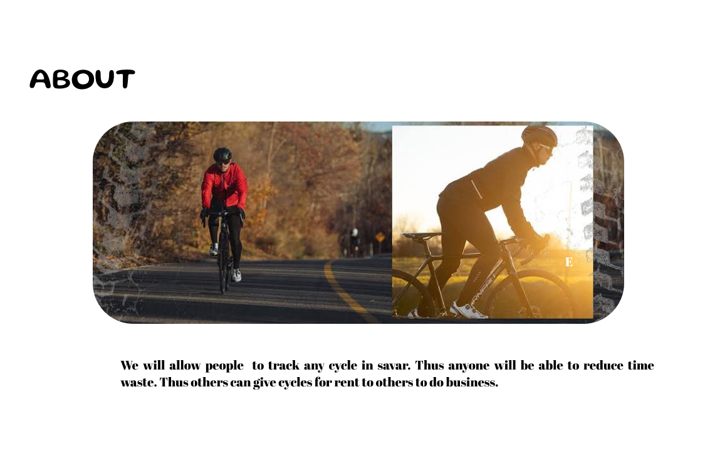
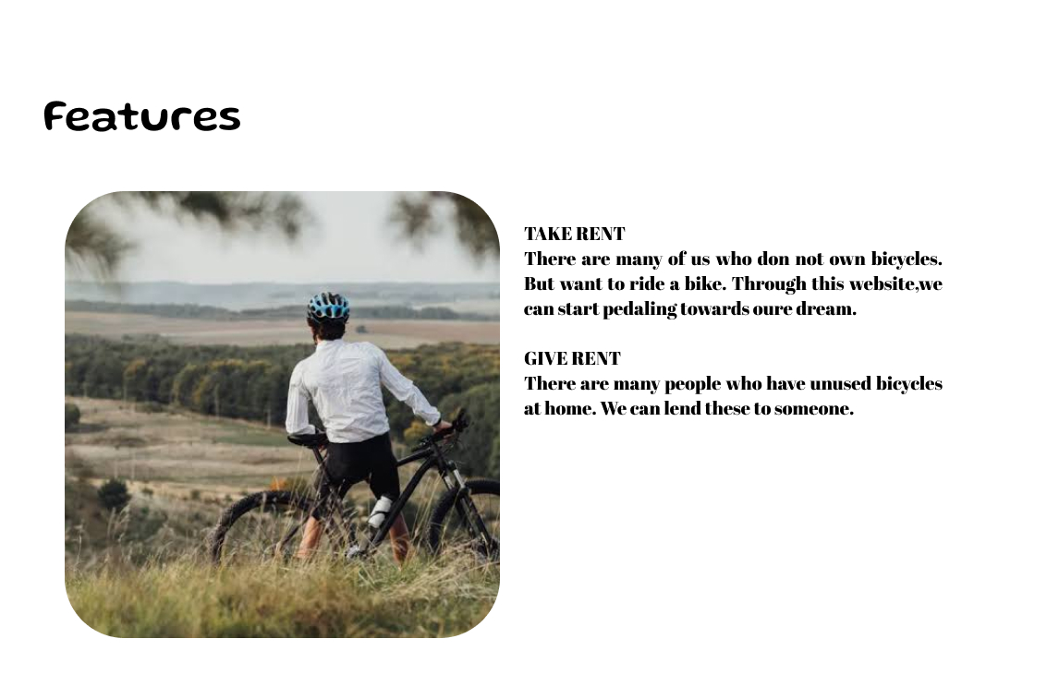
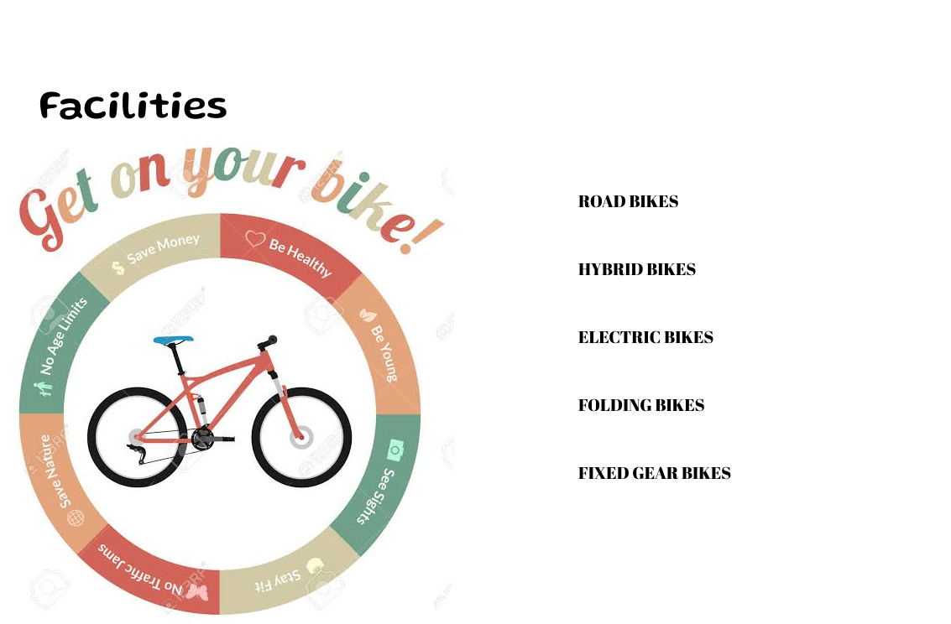

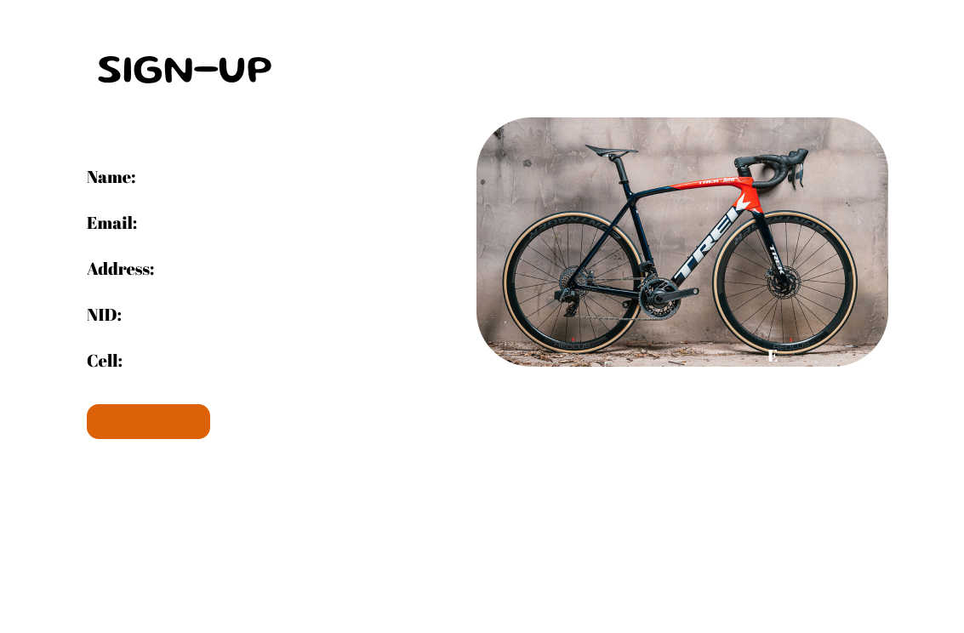
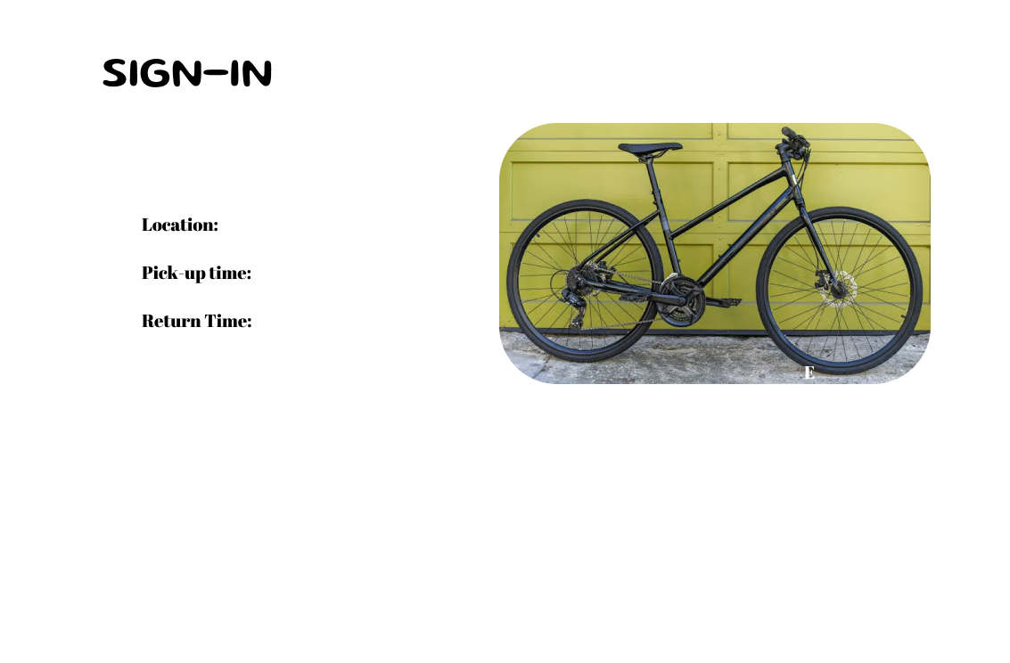
Design Phase
The design phase is created using Figma.
Software Project III Presentation

Slide 5
Development Phase
This is the development (html, css) part of this project. Here's the link: https://drive.google.com/drive/folders/1Ivk1mOLWwX9yeyDoadwMSoD81Ch2SLTy?usp=drive_link
Software Project III Presentation

Slide 6
Future Work
Add GPS system
Increase the geographical range
Add special cycles for womens
Software Project III Presentation

Slide 7
Conclusion
Allow people to track any cycle in Savar.
Able to reduce time waste.
Give cycles for rent to others to do business.
Use cycles as a daily life vehicle.
Utilize the unused one.
Software Project III Presentation

Slide 8
Thank You
Software Project III Presentation

